Slide 1
One Day OpenHack Azure Cosmos DB 20 Octobre 2022 Microsoft Customer Success Unit

Slide 2




Speaker info
Emmanuel Deletang
Global Black Belt Cosmos DB
edeletang@microsoft.com
Frederic Gisbert
Cloud Solutions Architect
frgisber@microsoft.com
Ali Bouhaddou
Cloud Solutions Architect
albouhad@microsoft.com
Franck Gaillard
Cloud Solution Architect
frgail@microsoft.com

Slide 3
House keeping
Run through Teams
General Channel – where we all come together
Private TeamXX channels for the Labs
Want to give everyone a chance to drive
Copies of materials will be provided after the event
Survey: link will be in posted General channel

Slide 4
Azure Data & AI technical intensity plan
From June 2022 to June 2023
Focus on "Azure Data & AI" tech intensity
Many content, from L100 Beginner to L400 Expert level:
Academy L100
Webinar L200/L300
Workshop L300/L400
Certification kickstart L300/L400
Openhack / Microhack L400

Slide 5
Data & AI events timeline – H1
Webinar/Academy- L 200/300
Workshop/ Openhack/ Certifications – L 300/400
Accompagnement certifications - DP-500 / DP-100
Kickstart (17/10)
Dry Run (14/11)
Q&A (05/12)
15 Sept
22 Sep
29 Sep
06 Oct
10 Oct
13 Oct
17 Oct
18 Oct
20 Oct
08 Nov
10 Nov
17 Nov
22 Nov
24 Nov
29 Nov
8 Déc
12 Déc
15 Déc
Synapse et Lakehouse Database
15/09
Deploiement et sécurisation des workspaces Azure Ml
Machine Learning dans Azure Synapse
Gouvernance de données dans Azure avec Microsoft Purview
MLOps avec Azure ML
Lab Lyon - Data & AI
Azure ML pour les Data Scientists
Workshop - MCPP DP-420
Academy DP900/AI900
&
Azure CosmosDB
SQL Server 2022 et hybridation native avec Azure SQL Managed Instance
Cosmos DB et IA
Azure Cognitive Services - L'IA sans code
Azure Synapse
Azure Scale Analytics - Architectures Data Mesh dans Azure avec Azure Synapse, Microsoft Purview et Azure Data Share
Lab Nantes - Data & AI
Le NoSQL dans Azure - Migration CosmosDB / OSS
L'IA dans les services de données Azure
Les solutions SQL dans Azure (PaaS, IaaS, SaaS)

Slide 6
Data & AI events timeline – H2
Webinar/Academy- L 200/300
Workshop/ Openhack/ Certifications – L 300/400
Accompagnement certifications - DP-203
Kickstart (xx)
Dry Run (xx)
Q&A (xx)
12 Jan
19 Jan
26 Jan
09 Feb
16 Feb
09 Mar
16 Mar
23 Mar
06 Apr
13 Apr
04 Mai
16 Mai
24 Mai
01 Juin
Academy DP900/AI900
15/09
Déploiement et sécurisartion des workspace Azure Synapse
Workshop - Open AI
Webinar - Self Service Analytics
Les bases de données Open Source dans le cloud Azure
Data processing dans Azure avec Azure Synapse, Azure Batch, Spark, Notebook, etc.
MLOps avec Azure Machine Learning
Machine Learning dans Azure Synapse
Gouvernance de données dans Azure avec Microsoft Purview
Azure ML pour les Citizen Data Scientists
Webinar - Self Service Analytics
Data processing dans Azure ave Azure Synapse, Azure Batch, Spark, Notebook, etc.
Les solutions SQL dans Azure (PaaS, IaaS, SaaS)
Responsible AI
Le edge/Hybrid Cloud - ML Processing - ML@edge, Percept, SQL@edge
Le edge/Hybrid Cloud - Data processing - SQL@edge, CEP@edge, Hyperscale, Arc, AKS

Slide 7
Liste des évènements de type Webinar 2H
Event Webinar (Les jeudis de la Data & AI) - L200/300 | Date | Duration (min) | Link
Azure Machine Learning pour les Data Scientists | 15/09/2022 | 120 | https://msevents.microsoft.com/event?id=2454281594
Azure Synapse | 22/09/2022 | 120 | https://msevents.microsoft.com/event?id=857781749
Les solutions SQL dans Azure (PaaS, IaaS, SaaS) | 29/09/2022 | 120 | https://msevents.microsoft.com/event?id=502366997
Déploiement et sécurisation des workspaces Azure Machine learning | 06/10/2022 | 120 | https://msevents.microsoft.com/event?id=1505714138
Azure Scale Analytics - Architectures Data Mesh dans Azure avec Azure Synapse, Microsoft Purview et Azure Data Share | 13/10/2022 | 120 | https://msevents.microsoft.com/event?id=139685175
MLOps avec Azure Machine Learning | 20/10/2022 | 120 | https://msevents.microsoft.com/event?id=1245885767
SQL Server 2022 et hybridation native avec Azure SQL Managed Instance | 10/11/2022 | 120 | https://msevents.microsoft.com/event?id=145826476
Machine Learning dans Azure Synapse Analytics | 17/11/2022 | 120 | https://msevents.microsoft.com/event?id=3637723312
Azure Cosmos DB et IA | 24/11/2022 | 120 | https://msevents.microsoft.com/event?id=2646013445
Azure et les Services Cognitifs | 08/12/2022 | 120 | https://msevents.microsoft.com/event?id=3772037220
La gouvernance de données dans Azure avec Microsoft Purview | 15/12/2022 | 120 | https://msevents.microsoft.com/event?id=1499560981
MLOps avec Azure Machine Learning | 12/01/2023 | 120 | https://msevents.microsoft.com/event?id=4115194515
Data processing dans Azure ave Azure Synapse, Azure Batch, Spark, Notebook, etc. | 19/01/2023 | 120 | https://msevents.microsoft.com/event?id=1537241181
Déploiement et sécurisation des workspace Azure Synapse | 26/01/2023 | 120 | https://msevents.microsoft.com/event?id=1806467748
Azure Machine Learning pour les Citizen Data Scientists | 09/02/2023 | 120 | En cours
PowerBI - Self Service Analytics | 16/02/2023 | 120 | https://msevents.microsoft.com/event?id=1401519679
L'IA responsable avec Azure machine learning | 09/03/2023 | 120 | https://msevents.microsoft.com/event?id=2072953112
Machine Learning dans Azure Synapse Analytics | 16/03/2023 | 120 | https://msevents.microsoft.com/event?id=3413014857
Les bases de données Open Source dans le cloud Azure | 23/03/2023 | 120 | https://msevents.microsoft.com/event?id=2727487131
Hybridation des services de Machine Learning Azure | 06/04/2023 | 120 | https://msevents.microsoft.com/event?id=1624914222
La gouvernance de données dans Azure avec Microsoft Purview | 13/04/2023 | 120 | https://msevents.microsoft.com/event?id=3909342839
Les solutions SQL dans Azure (PaaS, IaaS, SaaS) | 04/05/2023 | 120 | https://msevents.microsoft.com/event?id=1162207895
Data processing dans Azure ave Azure Synapse, Azure Batch, Spark, Notebook, etc. | 16/05/2023 | 120 | https://msevents.microsoft.com/event?id=3517068442
Hybridation des services de données Azure | 24/05/2023 | 120 | https://msevents.microsoft.com/event?id=2996507398
Self Service Analytics | 01/06/2023 | 120 | En cours

Slide 8
Liste des évènements de type Workshop/Prepa Cert/Academy
Event Workshop L300/400 | Date | Duration (min) | Link
Synapse et Lakehouse Database | 18/10/2022 | 120 | https://forms.office.com/Pages/ResponsePage.aspx?id=v4j5cvGGr0GRqy180BHbR3zwJTO3s11AuaqpNnBbrwdURE1RMVgwTDNISTE1TDFYSDVLR0cyS1kwWS4u
Le NoSQL dans Azure - Migration CosmosDB / OSS | 08/11/2022 | 120 | https://forms.office.com/Pages/ResponsePage.aspx?id=v4j5cvGGr0GRqy180BHbR3zwJTO3s11AuaqpNnBbrwdURE1RMVgwTDNISTE1TDFYSDVLR0cyS1kwWS4u
Lab Lyon - Data & AI | 22/11/2022 | 240 | https://forms.office.com/Pages/ResponsePage.aspx?id=v4j5cvGGr0GRqy180BHbR3zwJTO3s11AuaqpNnBbrwdUMlZZOURET0RSWjcyTERYRkJGTlFFUjJaUi4u
Lab Nantes - Data & AI | 29/11/2022 | 240 | https://forms.office.com/Pages/ResponsePage.aspx?id=v4j5cvGGr0GRqy180BHbR3zwJTO3s11AuaqpNnBbrwdUMlZZOURET0RSWjcyTERYRkJGTlFFUjJaUi4u
L'IA dans les services de données Azure | 12/12/2022 | 120 | https://forms.office.com/Pages/ResponsePage.aspx?id=v4j5cvGGr0GRqy180BHbR3zwJTO3s11AuaqpNnBbrwdURE1RMVgwTDNISTE1TDFYSDVLR0cyS1kwWS4u
Open AI | H2 | 120 | https://forms.office.com/Pages/ResponsePage.aspx?id=v4j5cvGGr0GRqy180BHbR3zwJTO3s11AuaqpNnBbrwdURE1RMVgwTDNISTE1TDFYSDVLR0cyS1kwWS4u
Event Academy, kickstart certifications, workshop certifications | Date | Duration (min) | Link
MCPP - DP-420 | 10/10/2022 | 420 | https://forms.office.com/Pages/ResponsePage.aspx?id=v4j5cvGGr0GRqy180BHbR3zwJTO3s11AuaqpNnBbrwdUMkJISlRKSU1RRFA0OVgzSFdTSTY0RE9WQy4u
Micro Hack CosmosDB | 20/10/2022 | 420 | H1 - Inscriptions PTA
Academy DP900 | 17-21/10/2022 | 300 | https://msevents.microsoft.com/event?id=3250818161
Academy AI900 | 17-21/10/2022 | 300 | https://msevents.microsoft.com/event?id=2717528090
Kickstart DP-500 | 17/10/2022 | 60 | https://forms.office.com/Pages/ResponsePage.aspx?id=v4j5cvGGr0GRqy180BHbR3zwJTO3s11AuaqpNnBbrwdUNEk3WFQ1TEdNNTQ2Uk85V0cxQzM3TE9ZRS4u
Dry Run DP-500 | 14/11/2022 | 120 | https://forms.office.com/Pages/ResponsePage.aspx?id=v4j5cvGGr0GRqy180BHbR3zwJTO3s11AuaqpNnBbrwdUNEk3WFQ1TEdNNTQ2Uk85V0cxQzM3TE9ZRS4u
Q&A DP-500 | 05/12/2022 | 90 | https://forms.office.com/Pages/ResponsePage.aspx?id=v4j5cvGGr0GRqy180BHbR3zwJTO3s11AuaqpNnBbrwdUNEk3WFQ1TEdNNTQ2Uk85V0cxQzM3TE9ZRS4u
Kickstart DP-100 | 17/10/2022 | 60 | https://forms.office.com/Pages/ResponsePage.aspx?id=v4j5cvGGr0GRqy180BHbR3zwJTO3s11AuaqpNnBbrwdUNDAxV0hSN0FHM1YzUzI3OUNMUFYxSkRIMi4u
Dry Run DP-100 | 14/11/2022 | 120 | https://forms.office.com/Pages/ResponsePage.aspx?id=v4j5cvGGr0GRqy180BHbR3zwJTO3s11AuaqpNnBbrwdUNDAxV0hSN0FHM1YzUzI3OUNMUFYxSkRIMi4u
Q&A DP-100 | 05/12/2022 | 90 | https://forms.office.com/Pages/ResponsePage.aspx?id=v4j5cvGGr0GRqy180BHbR3zwJTO3s11AuaqpNnBbrwdUNDAxV0hSN0FHM1YzUzI3OUNMUFYxSkRIMi4u
Kickstart DP-203 | 17/10/2022 | 60 | https://forms.office.com/Pages/ResponsePage.aspx?id=v4j5cvGGr0GRqy180BHbR3zwJTO3s11AuaqpNnBbrwdUOVFWOUVCNFcyQk5SVjFBUFczNktCUFpLMi4u
Dry Run DP-203 | 14/11/2022 | 120 | https://forms.office.com/Pages/ResponsePage.aspx?id=v4j5cvGGr0GRqy180BHbR3zwJTO3s11AuaqpNnBbrwdUOVFWOUVCNFcyQk5SVjFBUFczNktCUFpLMi4u
Q&A DP-203 | 05/12/2022 | 90 | https://forms.office.com/Pages/ResponsePage.aspx?id=v4j5cvGGr0GRqy180BHbR3zwJTO3s11AuaqpNnBbrwdUOVFWOUVCNFcyQk5SVjFBUFczNktCUFpLMi4u

Slide 9
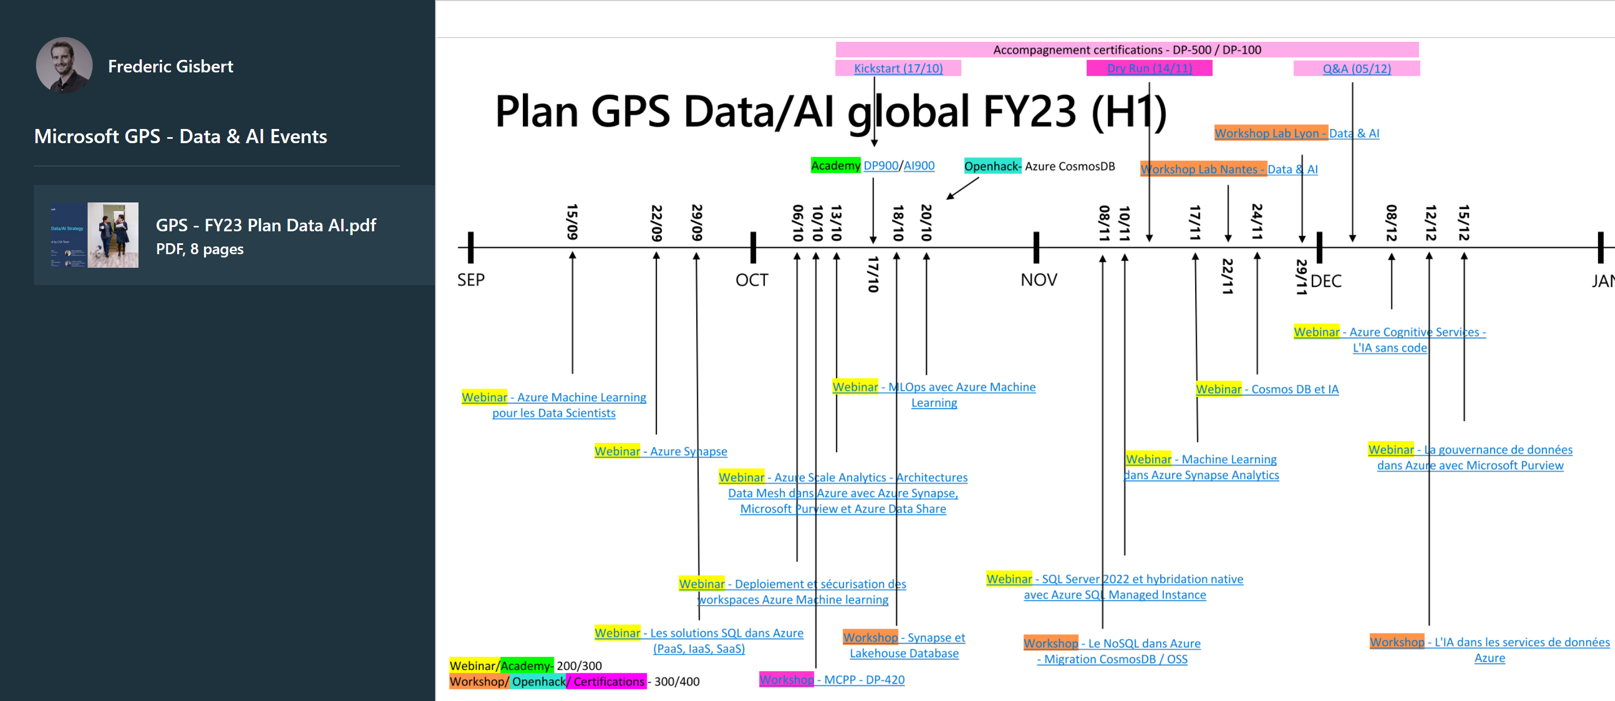
aka.ms/gpsdataevents

Slide 10
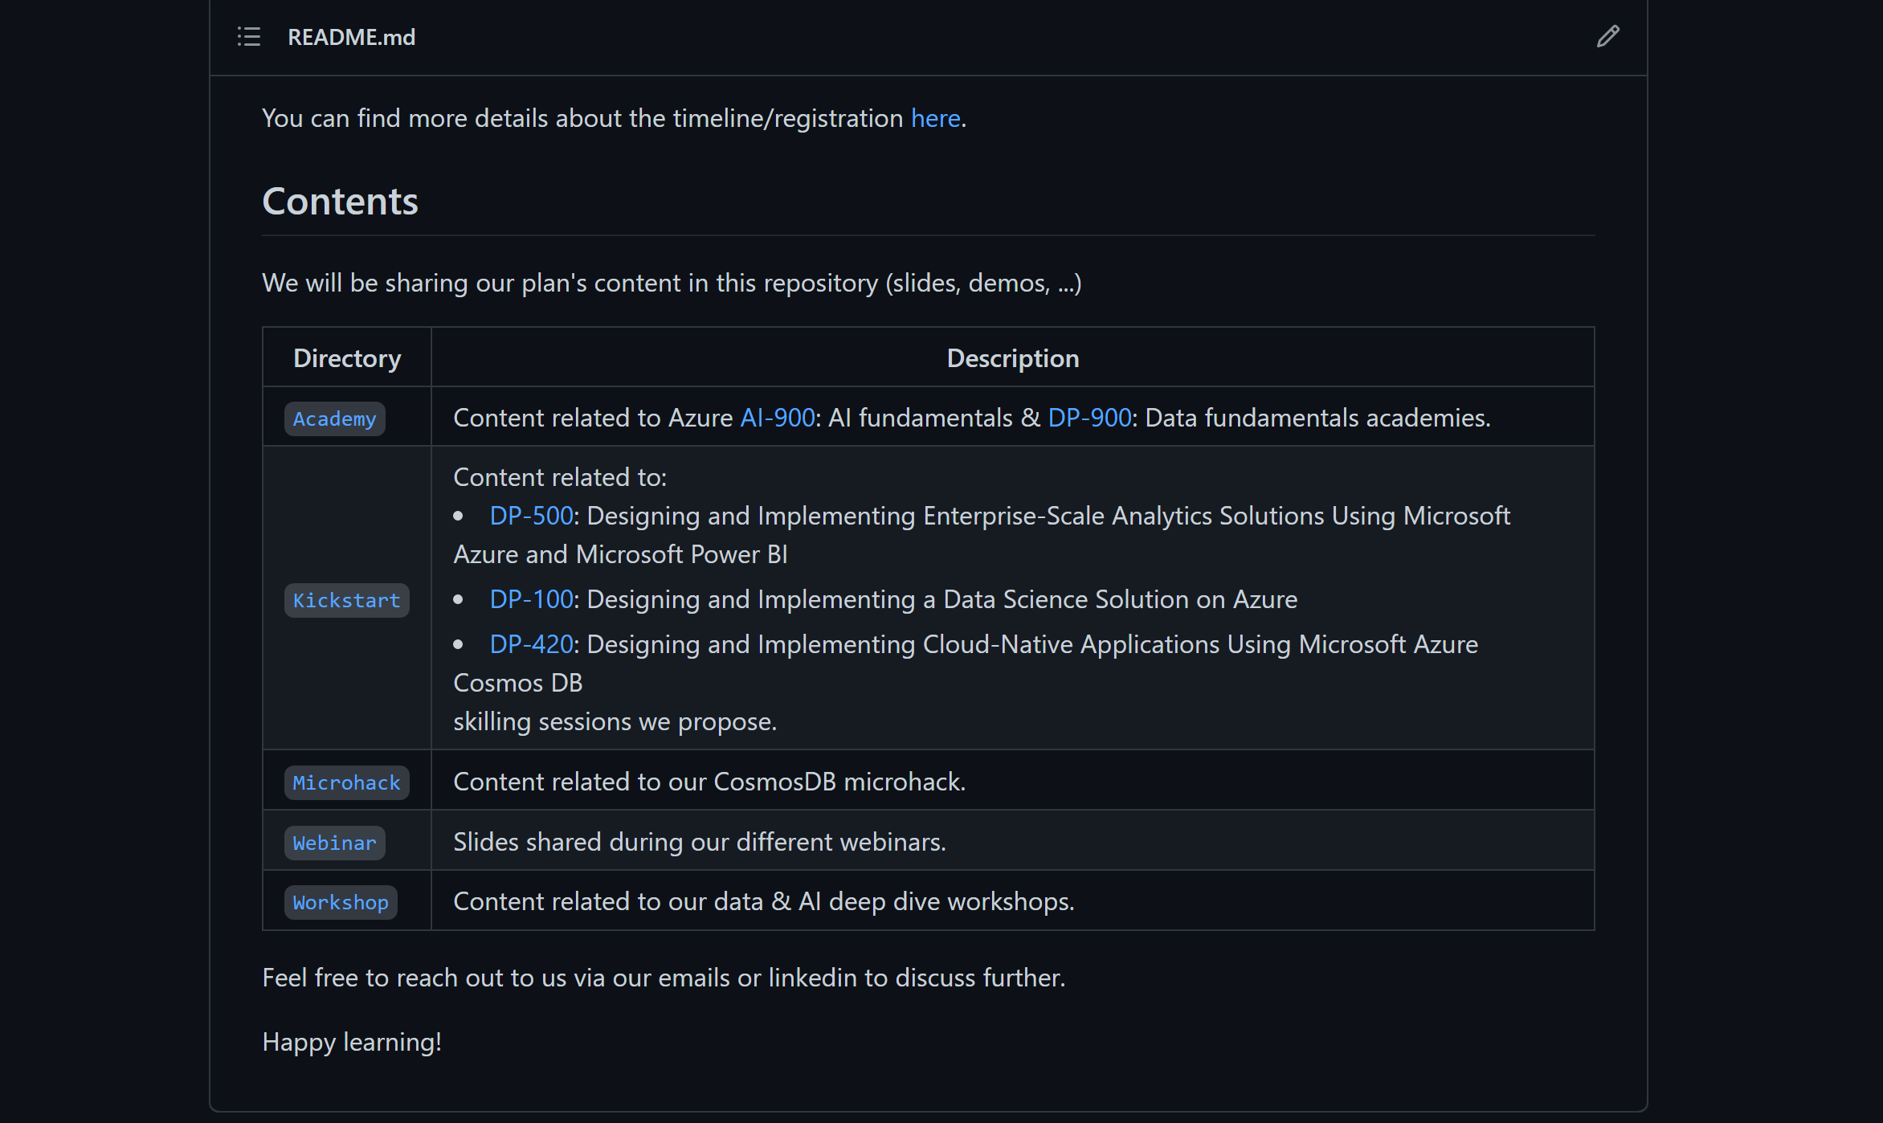
aka.ms/gpsdatamaterials

Slide 11
1-Day Cosmos OpeN HACK - Agenda
09:30 – 10:00 | Introduction, Overview, use case, Pricing & Value Proposition | Frédéric
10:00 – 10:10 | Lab environment overview | Franck
10:10 – 10:40 | Lab01: Importing Data into Azure Cosmos DB with Azure Data Factory | Teams
10:40 – 11:00 | Querying and Indexing | Ali
11h00 – 11h40 | LAB02-Querying and Indexing in Azure Cosmos DB | Teams
11h40 – 12h00 | Data Modeling, Partitioning | Emmanuel
12:00 – 13:30 | Lunch Break
13:30 – 14:15 | Data Modeling, Partitioning | Teams
14:20 – 14:50 | SQL API, CosmosDB Programming and SDKs, Change Feed , Synapse link | Emmanuel
14:50 – 15:30 | Lab 04: Implementing Azure Cosmos DB Change Feed | Teams
15:30 – 16:00 | Lab 05: Synapse Link | Teams
16:00 – 16:30 | Open discussion | All
16:30 – 16:45 | Closing Comments & open Q&A & Fill the Survey Form | All

Slide 12
Modern apps face new challenges
Managing and syncing data distributed around the globe
Delivering highly-responsive, real-time personalization
Processing and analyzing large, complex data
Scaling both throughput and storage based on global demand
Offering low-latency to global users
Modernizing existing apps and data

Slide 13

Azure Cosmos DB
A fully managed NoSQL database for modern app development with SLA-backed speed and availability, automatic and instant scalability, and open source APIs for MongoDB, Cassandra, and other NoSQL engines.
Guaranteed speed at any scale
Simplified application development
Mission-critical ready
Fully managed and cost-effective
Guarantee business continuity, 99.999% availability, and enterprise-level security for every application.
End-to-end database management with serverless and automatic scaling matching your application and TCO needs.
Gain unparalleled SLA-backed speed and throughput, fast global access, and instant elasticity.
Build fast with open source APIs, multiple SDKs, schemaless data, and no-ETL analytics over operational data.

Slide 14



Azure Cosmos DB
Fast NoSQL database with open APIs for any scale
Core (SQL) API
MongoDB
Table API
Column-family
Document
Key-value
Graph
Guaranteed <10 ms latency and 99.999% availability
Instant, elastic and automatic scalability
Data replication in any Azure region
Turnkey multi-master writes
Fully managed and serverless

Slide 15
Turnkey global distribution
PUT YOUR DATA WHERE YOUR USERS ARE IN MINUTES
Automatically replicate all your data around the world, and across more regions than AWS and Google Cloud Platform combined.
Available in all Azure regions
Manual and automatic failover
Automatic & synchronous multi-region replication

Slide 16
ELASTIC SCALE OUT OF STORAGE AND THROUGHPUT
SCALES AS YOUR APPS’ NEEDS CHANGE
Independently and elastically scale storage and throughput across regions – even during unpredictable traffic bursts – with a database that adapts to your app’s needs.
Elastically scale throughput from 10 to 100s of millions of requests/sec across multiple regions
Support for requests/sec for different workloads
Pay only for the throughput and storage you need

Slide 17
GUARANTEED LOW LATENCY
PROVIDE USERS AROUND THE WORLD WITH FAST ACCESS TO DATA
Serve <10 millisecond read and write requests at the 99th percentile from the region nearest to users, while delivering data globally.

Slide 18
FIVE WELL-DEFINED CONSISTENCY MODELS (1 of 2)
CHOOSE THE BEST CONSISTENCY MODEL FOR YOUR APP
Offers five consistency models
Provides control over performance-consistency tradeoffs, backed by comprehensive SLAs.
An intuitive programming model offering low latency and high availability for your planet-scale app.
Strong
Bounded-stateless
Session
Consistent prefix
Eventual

Slide 19
Multiple data models and apis
USE THE MODEL THAT FITS YOUR REQUIREMENTS, AND THE APIS, TOOLS, AND FRAMEWORKS YOU PREFER
Choose from multiple APIs to access and query data, including Core (SQL), MongoDB, Cassandra, Gremlin, and Table.
Use key-value, tabular, graph, and document data
Data is automatically indexed, with no schema or secondary indexes required.
Core (SQL) API
MongoDB
Table API
Column-family
Document
Key-value
Graph

Slide 20
COMPREHENSIVE SLAs
RUN YOUR APP ON WORLD-CLASS INFRASTRUCTURE
Azure Cosmos DB is the only service with financially-backed SLAs for single-digit millisecond read and write latency at the 99th percentile, 99.999% high availability and guaranteed throughput and consistency
Latency
High Availability
Throughput
Consistency
<10 ms
99.999%
Guaranteed
Guaranteed
99th percentile
Notes:
HA 99.999% for multi-region read; 99.99% for single region deployments

Slide 21
Handle any data with no schema or indexing required (1 of 2)
Azure Cosmos DB’s schema-less service automatically indexes all your data, regardless of the data model, to delivery blazing fast queries.
Automatic index management
Synchronous auto-indexing
No schemas or secondary indices needed
Works across every data model
GEEK
Item | Color | Microwave safe | Liquid capacity | CPU | Memory | Storage
Geek mug | Graphite | Yes | 16ox | ??? | ??? | ???
Coffee Bean mug | Tan | No | 12oz | ??? | ??? | ???
Surface book | Gray | ??? | ??? | 3.4 GHz Intel Skylake Core i7-6600U | 16GB | 1 TB SSD

Slide 22
Top 10 reasons why customers use Azure Cosmos DB
The 1st and only database with global distribution turnkey capability
Deliver massive storage/throughput scalability database
Provides guaranteed single digit millisecond latency at 99th percentile worldwide
Natively supports different types of data at massive scale
Boasts 5 well-defined consistency models to pick the right consistency/latency/ throughput tradeoff
Enables mission critical intelligent applications
Gives high flexibility to optimize for speed and cost
Tackles big data workloads with high availability and reliability
Provides multi-tenancy and enterprise-grade security
Naturally analytics-ready and perfect for event-driven architectures

Slide 23
Powering global solutions
Azure Cosmos DB was built to support modern app patterns and use cases.
It enables industry-leading organizations to unlock the value of data, and respond to global customers and changing business dynamics in real-time.
Data distributed and available globally
Build real-time customer experiences
Ideal for gaming, IoT & eCommerce
Simplified development with serverless architecture
Run Spark analytics over operational data
Lift and shift NoSQL data
Puts data where your users are
Enable latency-sensitive personalization, bidding, and fraud detection.
Predictable and fast service, even during traffic spikes
Fully-managed event-driven micro-services with elastic computing power
Accelerate insights from fast, global data
Lift and shift MongoDB and Cassandra workloads

